Slide 2






Unscheduled Processes
Process Scheduler
Ready Queue
CPU

Slide 3
Process A
Core 1
Process Scheduler
Process B
Core 2
Process C
Core 3
Thread 1
Thread 2
Core 4
Process D

Slide 4
Processor 1
Process Scheduler
Processor 2
Unscheduled Tasks
Processor 3
Processor 4

Slide 5
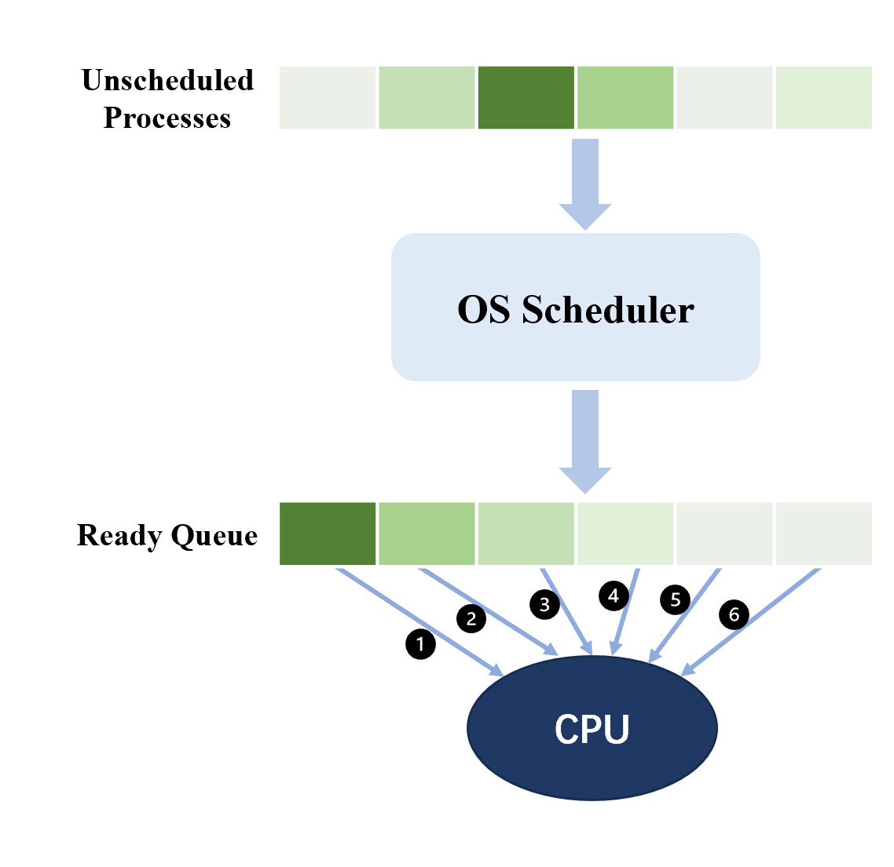
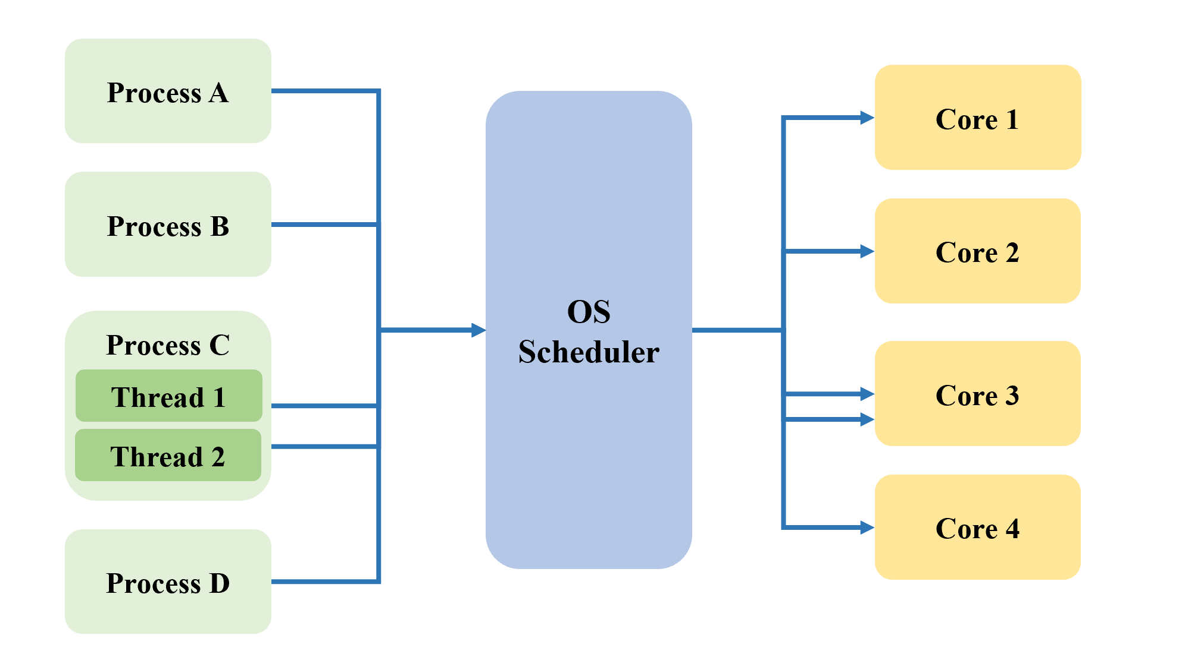
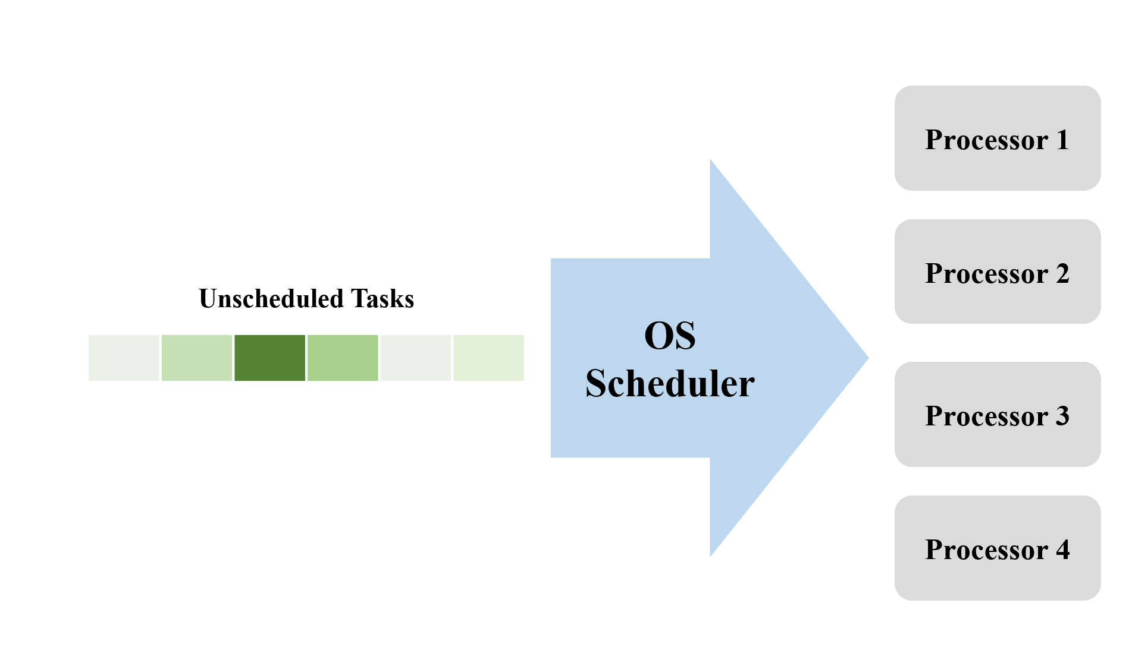
(a) Single Processor Scheduling
(b) Many-core Scheduling
(c) Multi-processor Scheduling

Slide 6



Storage Devices
Application1 Request
I/O Scheduler
Application2 Request
Add Request
Dispatch
Application3 Request
…
I/O Scheduling

Slide 7
1st Request
I/O Request
Data
2nd Request
Data
Evict old?
Cache Management Unit
Cache
Cache new?

Slide 8
